Slide 1
data science with python
Basic Stats

Slide 2
Basic stats

Slide 3
Basic stats
Central Tendency
Distribution of the Data
Confidence Intervals
Hypothesis Tests

Slide 4
CENTRAL TENDENCY
variable summarization
the value used to characterize the center of the set of values it contains.
descriptive statistical approaches
mode,
median
the mean.

Slide 5
Mode
What is it | Comments
following variable whose values (after being ordered from low to high) are 3, 4, 5, 6, 7, 7, 7, 8, 8, 9 | The mode is a useful indication of the central tendency of a variable, since the most frequently occurring value is often toward the center of the variable’s range.
The mode would be the value 7 since there are three occurrences of 7 (more than any other value). | Mode provides the only measure of central tendency for variables measured on a nominal scale;
When there is more than 1 value with the same (and highest) number of occurrences, either all values are reported or a midpoint is selected. For example, for the following values, both 7 and 8 are reported 3 times: 3, 4, 5, 6, 7, 7, 7, 8, 8, 8, 9 The mode may be reported as {7, 8} or 7.5. | mode can also be calculated for variables measured on the ordinal, interval, and ratio scales

Slide 6
Median
What is it | Comments
The median is the middle value of a variable, once it has been sorted from low to high. The following set of values for a variable will be used to illustrate: 3, 4, 7, 2, 3, 7, 4, 2, 4, 7, 4 | The median can be calculated for variables measured on the ordinal, interval, and ratio scales
Before identifying the median, the values must be sorted: 2, 2, 3, 3, 4, 4, 4, 4, 7, 7, 7 | often the best indication of central tendency for variables measured on the ordinal scale.
There are 11 values and therefore the sixth value (five values above and five values below) is selected as the median value, which is 4: 2, 2, 3, 3, 4, 4, 4, 4, 7, 7, 7 | good indication of the central value for a variable measured on the interval or ratio scales
For variables with an even number of values, the average of the two values closest to the middle is selected | unlike the mean, it will not be distorted by extreme values.

Slide 7
Mean
What is it | Comments
defined as the sum of all the values divided by the number of values. For example, for the following set of values: 3, 4, 5, 7, 7, 8, 9, 9, 9 | Good for continuous variables
The sum of all nine values is (3 + 4 + 5 + 7 + 7 + 8 + 9 + 9 + 9) or 61. The sum divided by the number of values is 61 ÷ 9 or 6.78. | Affected by noise and outliers

Slide 8
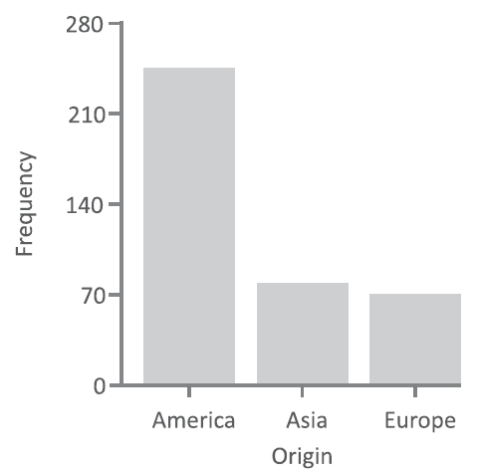
DISTRIBUTION OF THE DATA
the central location is a single value that characterizes an individual variable’s data values, it provides no insight into the variation of the data
The frequency distribution, which is based on a simple count of how many times a value occurs, is often a starting point for the analysis of variation.
performed using simple data visualizations and calculated metrics.

Slide 9
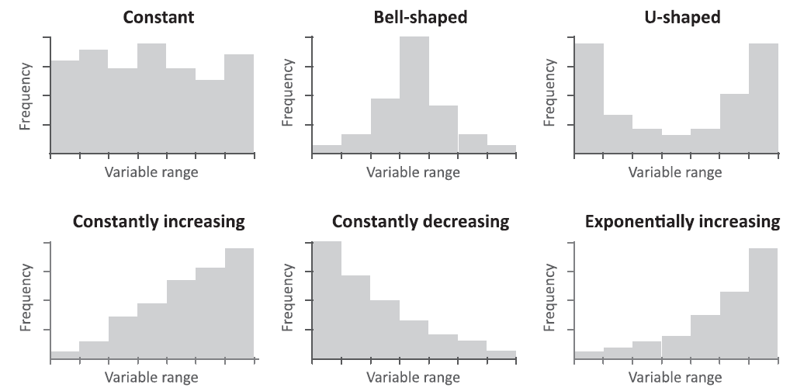
frequency histograms
As the values increase, the number of observations in each group remains constant
centered around the mean value, symmetrical, BELL shape, NORMAL distribution
bimodal distribution where the values cluster in two locations
Linearly increasing
Linearly decreasing
Exponential decreasing

Slide 10
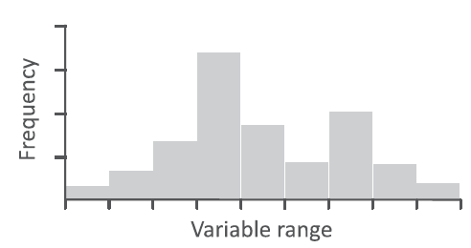
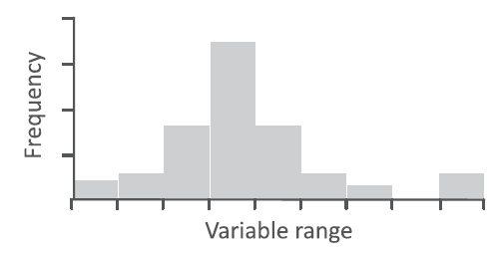
What do frequency histograms tell us?
if there is something unusual about the variables.
1st histogram : appears to contain 2 approximately normal distributions and leads us to question whether the data table contains 2 distinct types of observations, each with a separate frequency distribution
2nd histogram : appears to be a small number of high values that do not follow the bell-shaped distribution that the majority of observations follow. In this case, it is possible that these values are errors and need to be further investigated.

Slide 11
Range
The range is a simple measure of the variation for a particular variable.
It is calculated as the difference between the highest and lowest values.
The following variable
2, 3, 4, 6, 7, 7, 8, 9
The range is 7 calculated from the highest value (9) minus the lowest value (2).
Ranges can be used with variables measured on an ordinal, interval, or ratio scale.

Slide 12
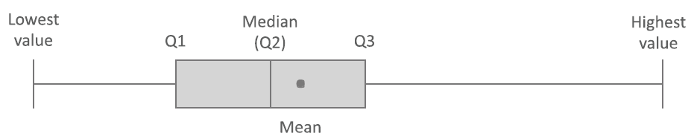
Quartiles
Quartiles divide a continuous variable into 4 even segments based on the number of observations.
The first quartile (Q1) is at the 25% mark, the second quartile (Q2) is at the 50% mark, and the third quartile (Q3) is at the 75% mark.
The calculation for Q2 is the same as the median value
The following list of values …3, 4, 7, 2, 3, 7, 4, 2, 4, 7, 4
The values are initially sorted: 2, 2, 3, 3, 4, 4, 4, 4, 7, 7, 7
Next, the median or Q2 is located in the center: 2, 2, 3, 3, 4, 4, 4, 4, 7, 7, 7
We now look for the center of the first half or Q1: 2, 2, 3, 3, 4, 4, 4, 4, 7, 7, 7
Finally, we look for the center of the second half or Q3: 2, 2, 3, 3, 4, 4, 4, 4, 7, 7, 7
The interquartile range is defined as the range from Q1 to Q3. In this example it would be 7 − 3 = 4.

Slide 13
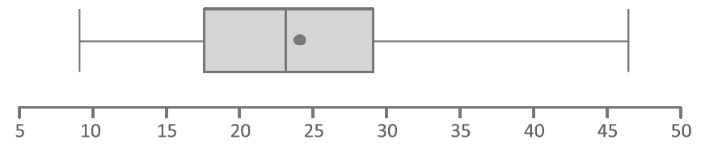
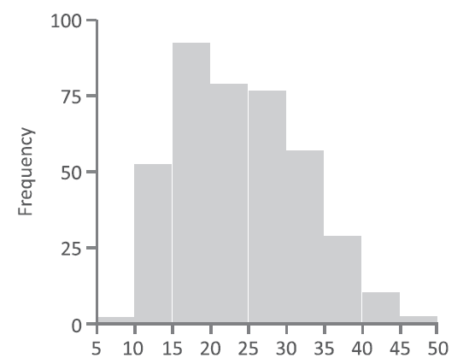
Box Plots
Box plots provide a summary of the overall frequency distribution of a variable. 6 values are usually displayed:
the lowest value,
the lower quartile (Q1),
the median (Q2),
the upper quartile (Q3),
the highest value,
and the mean.
lower (9) and upper (46.6) variable.
50% of observations begin at the lower quartile (Q1=17.5)
end at the upper quartile (Q3=29).
mean (around 23.6)
the median (23)

Slide 14
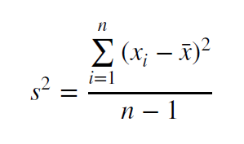
Variance
The variance describes the spread of the data and measures how much the values of a variable differ from the mean.
For variables that represent only a sample of some population and not the population as a whole, the variance formula is
The variance reflects the average squared deviation and can be calculated for variables measured on the interval or ratio scale.
A variance value of zero represents that all of the values within a data set are identical, while all variances that are not equal to zero will come in the form of positive numbers.
The larger the variance, the more spread in the data set.
A large variance means that the numbers in a set are far from the mean and each other. A small variance means that the numbers are closer together in value.

Slide 15
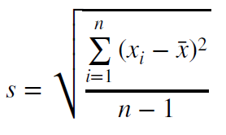
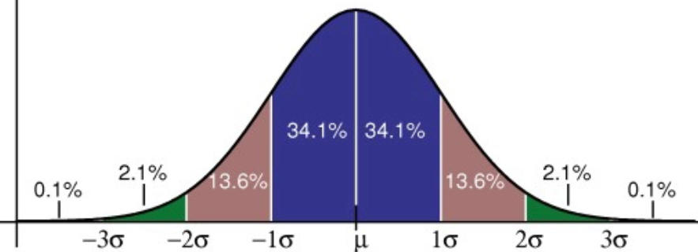
Standard Deviation
The standard deviation is the square root of the variance.
For a sample from a population, the formula is:
The higher the value, the more widely distributed the variable’s data values are around the mean.
Assuming the frequency distribution is approximately normal (i.e., a bell-shaped curve),
about 68% of all observations will fall within 1 standard deviation of the mean
68% of the data falls within 1 standard deviation.
95% of the data falls within 2 standard deviations.
99.7% of the data falls within 3 standard deviations
For example, a variable has a mean value of
45 with a standard deviation value of 6.
- Approximately 68% of the observations should be in the range 39–51, 95% would be in the range of 33-57

Slide 16
Covariance - COV
Covariance provides insight into how two variables are related to one another.
More precisely, covariance refers to the measure of how two random variables in a data set will change together.
A positive covariance means that the two variables at hand are positively related, and they move in the same direction.
A negative covariance means that the variables are inversely related, or that they move in opposite directions.
Covariance always has units
In a finance context, covariance is the term used to describe how two stocks will move together.

Slide 17
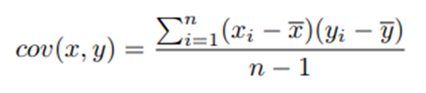
Calculate Covariance - COV
In this formula,
X represents the independent variable,
Y represents the dependent variable,
N represents the number of data points in the sample,
x-bar represents the mean of the X and
y-bar represents the mean of the dependent variable Y.
Covariance values are not standardized. COV values ranges from -∞ to +∞
With covariance, there is no minimum or maximum value, so the values are more difficult to interpret. For example, a covariance of 50 may show a strong or weak relationship; this depends on the units in which covariance is measured.

Slide 18

correlation
Correlation is defined as covariance normalized by the product of standard deviations, so the correlation between X and Y
Correlation coefficients are standardized.. value is always between –1 and 1
Correlation does not have units.
For example,
a correlation of 0.9 indicates a very strong relationship in which two variables nearly always move in the same direction;
a correlation of –0.1 shows a very weak relationship in which there is a slight tendency for two variables to move in opposite directions.

Slide 19
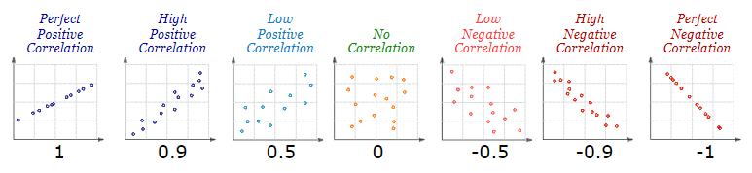
Corr - ex
Correlation can have a value:
1 is a perfect positive correlation
0 is no correlation (the values don't seem linked at all)
-1 is a perfect negative correlation

Slide 20
collinearity and multicollinearity
Collinearity occurs when 2 predictor variables (e.g. x1 and x2) in a multiple regression have a non-zero correlation.
Multicollinearity occurs when more than 2 predictor variables (e.g., x1, x2 and x3) are inter-correlated.

Slide 21
Multicollinearity
Multicollinearity, or collinearity, is the existence of near-linear relationships among the independent variables.
For example, suppose that the 3 ingredients of a mixture are studied by including their percentages of the total.
Variables will have the (perfect) linear relationship: P1 + P2 + P3 = 100.
During regression calculations, this relationship causes a division by zero which in turn causes the calculations to be aborted.

Slide 22
example
 | Y | X1 | X2 | X3
Y | 1.0
X1 | .72 | 1.0
X2 | .67 | .75 | 1.0
X3 | .60 | .85 | .85 | 1.0
X1 and X2 have strong collinearity with X3.
This will increase the variance in column X3 if regressed with X1 and X2

Slide 23
Why is it imp - Affect of Multicollinearity
Has the potential to adversely affect the regression analysis
Coefficients
Standard errors
Significance levels
R2 will be large but the individually the beta weights may not be statistically significant
Wrongly directed Beta estimates
Analysis will not work

Slide 24
Detection of Multicollinearity
Pairwise scatter plots of pairs of independent variables, looking for near-perfect relationships.
Glance at the correlation matrix for high correlations.
Unfortunately, multicollinearity does not always show up when considering the variables 2 at a time.
Multicollinearity more troublesome to detect because it occurs when 3 or more variables, which are highly correlated, are included within a model.
Consider the variance inflation factors (VIF). VIFs over 10 indicate collinear variables.
Eigenvalues of the correlation matrix of the independent variables near zero indicate multicollinearity.

Slide 25
Variance Inflation Factor (VIF)
The Variance Inflation Factor (VIF) is a measure of collinearity among predictor variables within a multiple regression.
It is calculated by taking the ratio of the variance of all a given model's betas divide by the variance of a single beta if it were fit alone.

Slide 26
Variance Inflation Factor (VIF)
Steps for Implementing VIF
Run a multiple regression. Calculate the VIF factors.
Inspect the factors for each predictor variable, if the VIF is between 5-10, multicollinearity is likely present and consider dropping the variable.
VIFs start at 1 and have no upper limit.
A value of 1 indicates that there is no correlation between this independent variable and any others.
VIFs between 1 and 5 suggest that there is a moderate correlation, but it is not severe enough to warrant corrective measures.
VIFs greater than 5 represent critical levels of multicollinearity where the coefficients are poorly estimated, and the p-values are questionable.

Slide 27
What can we do about multi-collinearity?
Check if the one the predictor variable is a duplicate
Remove redundant variables
Aggregate similar variables
Increase sample size

Slide 28
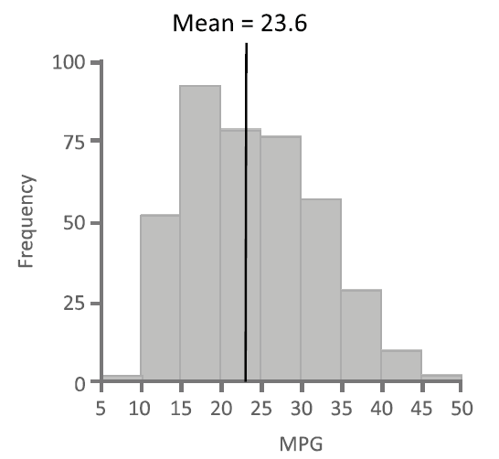
Shape - skewness
Use of histograms to visualize the frequency distribution.
Also, Use methods for quantifying the lack of symmetry or skewness in the distribution of a variable.
For asymmetric distributions, the bulk of the observations are either to the left or the right of the mean.
the frequency distribution is asymmetric and more of the observations are to the left of the mean than to the right
the right tail is longer than the left tail.
This is an example of a positive, or right skew.
Similarly, a negative, or left skew would have more of the observations to the right of the mean value with a longer tail on the left.

Slide 29
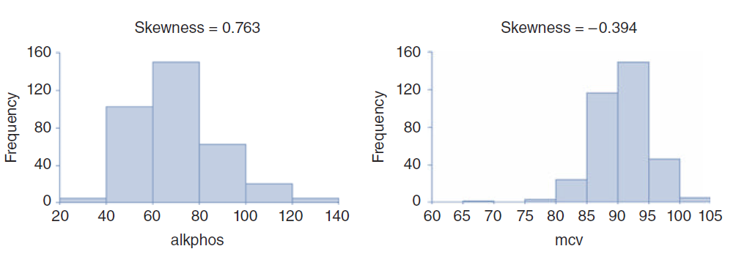
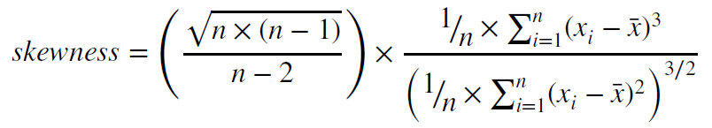
Skewness metric
A skewness value of 0 indicates a symmetric distribution.
If the lower tail is longer than the upper tail the value is positive;
if the upper tail is longer than the lower tail, the skewness score is negative.
The variable alkphos in the plot on the left has a positive skewness value of 0.763, indicating that the majority of observations are to the left of the mean,
whereas the negative skewness value for the variable mcv in the plot on the right indicates that the majority are to the right of the mean.

Slide 30
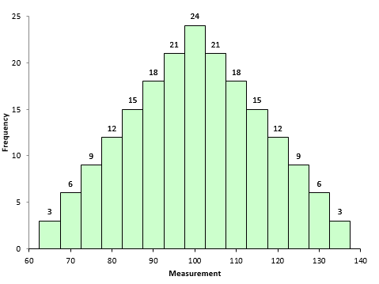
So, when is the skewness too much?
The rule of thumb seems to be:
If the skewness is between -0.5 and 0.5, the data are fairly symmetrical.
If the skewness is between -1 and -0.5(negatively skewed) or between 0.5 and 1(positively skewed), the data are moderately skewed.
If the skewness is less than -1(negatively skewed) or greater than 1(positively skewed), the data are highly skewed.
Suppose we have house values ranging from $100k to $1,000,000 with the average being $500,000.
If the peak of the distribution was left of the average value, portraying a positive skewness. - means many houses being sold for less than the average value, i.e. $500k.
If the peak of the distributed data was right of the average value, that would mean a negative skew. means that the houses being sold for more than the average value.
Symmetrical Dataset with Skewness = 0

Slide 31
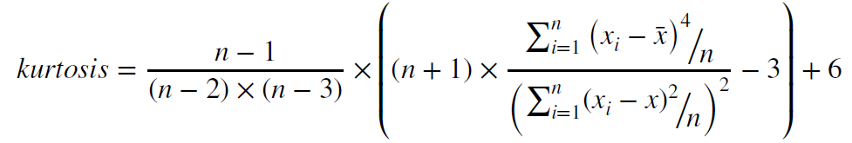
peak of the distribution
In addition to the symmetry of the distribution, the type of peak of the distribution has should be considered and it can be characterized by a measurement called kurtosis
Variables with a pronounced peak near the mean have a high kurtosis score
Variables with a flat peak have a low kurtosis score.
Values for skewness and kurtosis close to 0 indicate that the shape of a frequency distribution for a variable approximates a normal distribution
Kurtosis for a normal distribution is 3
Kurtosis higher than 3 indicates that the shape is thinner
a kurtosis lower than 3 indicates that the shape is flatter
Kurtosis is important because it may indicate problems with the data, even when the distribution is symmetric.

Slide 32

z-score (normalized value)
Z-score : for each data element that represents the number of standard deviations that element’s value is from the mean.
A z-score of 0 indicates that a data element’s value is the same as the mean,
data elements with z-scores greater than 0 have values greater than the mean,
data elements with z-scores less than 0 have values less than the mean.
The magnitude of the z-score reflects the number of standard deviations that value is from the
mean.
This calculation can be useful for comparing variables measured on different scales.

Slide 33
CONFIDENCE INTERVALS
So far we saw summarizing information on a set of randomly collected observations.
This summary information is usually referred to as statistics as they summarize only a collection of observations that is a subset of a larger population.
information derived from a sample of observations can only be an approximation of the entire population.
To make a definitive statement about an entire population, every member of that population would need to be measured.
It is possible, however, to make estimates about a population by using confidence intervals

Slide 34
sample distributions
Sample distributions - how a statistic, such as the mean or mode, calculated from a single sample can reliably be used to infer a corresponding value of the population
E,g, - statistic mean for the weight of males is 70kgs
Another random sample with the same number of observations - means of the two samples would be close but not identical.
Many random samples of equal size and calculate the mean value from each sample, we would begin to form a frequency distribution.
infinitely many samples of equal size and plot on a graph the value of the mean calculated from each sample, it would produce a normal frequency distribution - sampling distribution of the mean

Slide 35
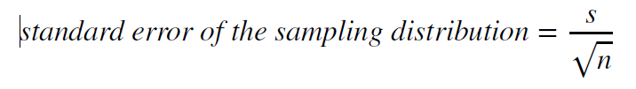
sample distributions
Just as the distributions for a statistical variable have a mean and a standard deviation, so also does the sampling distribution.
The mean of a sampling distribution is called the expected value of the mean
standard deviation of the sampling distribution is called the standard error
Sample size of at least 30 observations
s is the standard deviation of a sample and
n is the number of observations in the sample.

Slide 36
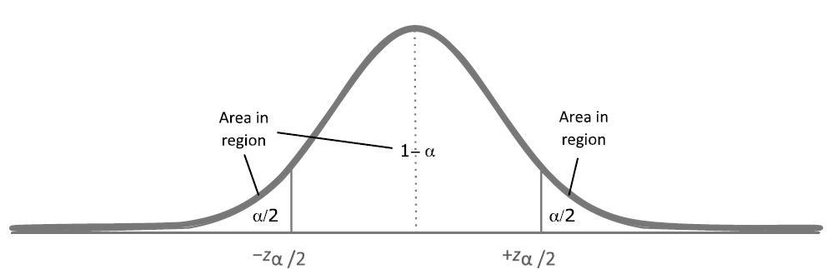
95% confidence level
Confidence intervals are often based on a 95% confidence level, but sometimes a more stringent 99% confidence level or less stringent 90% level is used
Interpretation - on average, the correct population value will be found within the derived confidence interval 95 times out of every 100 samples collected
confidence interval = 100 × (1 − 𝛼)
For a 90% confidence level alpha is 0.1; for a 95% confidence level alpha is 0.05; for a 99% confidence level 𝛼 is 0.01;

Slide 37
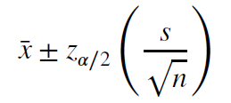
confidence interval
E.X - the fuel efficiency of 100 specific cars is measured and a
mean value of 30.35 kmpl is calculated with a standard deviation of 2.01.
Using an alpha value of 0.05 (which translates into a z_{𝛼∕2} value of 1.96)
Hence, the confidence interval for the average fuel efficiency is 30.35 ± 0.393 or between 29.957 and 30.743
where ̄x is the mean value,
s is the standard deviation,
and n is the number of observations in the sample.
The value for z_{𝛼∕2} is based on the area to the right of a standard z-distribution

Slide 38
HYPOTHESIS TESTS
Ex: The Scenario
a company manufacturing hair care products claims that the average amount of shampoo within the bottles is 200 mL.
To test this hypothesis, the company collects a random sample of 100 shampoo bottles and precisely measures the contents of the bottle.
If it is inferred from the sample that the average amount of shampoo in each bottle is not 200 mL then a decision may be made to stop production and rectify the manufacturing problem.

Slide 39
formulate the hypothesis
null hypothesis : the average volume of shampoo in a bottle is 200 mL.
alternative hypothesis : (H_{a}) is that they differ or, stated in a way that can be measured, that the average is not equal to 200 mL.
For this example, the null hypothesis and alternative hypothesis would be shown as
H₀ : 𝜇 = 200
H_{a} : 𝜇 ≠ 200

Slide 40
context
This hypothesis will be tested using the sample data collected to determine whether the mean value is different enough to warrant rejecting the null hypothesis.
The result of a hypothesis test is either to fail to reject or reject the null hypothesis.
Since we are only looking at a sample of the observations - we are not testing every bottle being manufactured – it is impossible to make a statement about the average with total certainty.
Consequently, it is possible to reach an incorrect conclusion.
2 categories of errors that can be made.
Type 1 error : Reject the null hypothesis when, in fact, the null hypothesis is true error);
Type II error : Accept the null hypothesis when it should be rejected
The threshold of probability used to determine a type I error is decided before performing the test, referred to as the level of significance or 𝛼

Slide 41
Set the level of significance
level of significance or 𝛼, is often set to 0.05 (5% chance of a type I error);
however, more stringent (such as 0.01 or 1%)
or less stringent values (such as 0.1 or 10% chance)

Slide 42
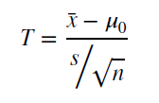
specify the standardized test statistic (T)
We have to determine whether the mean of the sample data we collected is either meaningfully or trivially different from the population mean.
Is it likely that we would find as great a difference from the population average
if we were to collect other random samples of the same size and compare their mean values?
we use the following formula to calculate the test statistic:

Slide 43
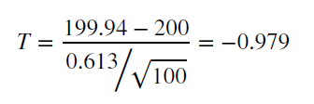
calculation
̄x is the calculated mean value of the sample,
𝜇0 is the population mean that is the subject of the hypothesis test,
s is the standard deviation of the sample, and n is the number of observations. (
the denominator is the standard error of the sampling distribution
average shampoo bottle volume measured over the 100 samples (n) is 199.94
and the standard deviation is 0.613 (s).

Slide 44
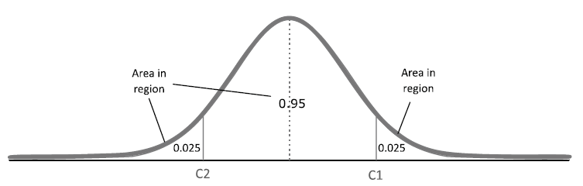
decision
Level of significance 𝛼 = 0.05
Identify a range of values where 95% of all the sample means would lie.
Estimate regions to accept the null hypothesis. This region has two critical upper and lower bound values C1 and C2.
95% of all sample means lie between these values and 5% lie outside these values (0.025 below C2 and 0.025 above C1)
Reject the null hypothesis if the value of T is outside this range (i.e., greater than C1 or less than C2) or Accept the null hypothesis if it is inside the range.
Since T is −0.979 and is greater than −1.96 and less than +1.96, The null hypothesis stands and conclude that the value is within the acceptable range

